Slide 1
14-Nov
Friday
Embedded AI & Robotics
Week 1 – Course Intro & First Steps with Arduino

Slide 2
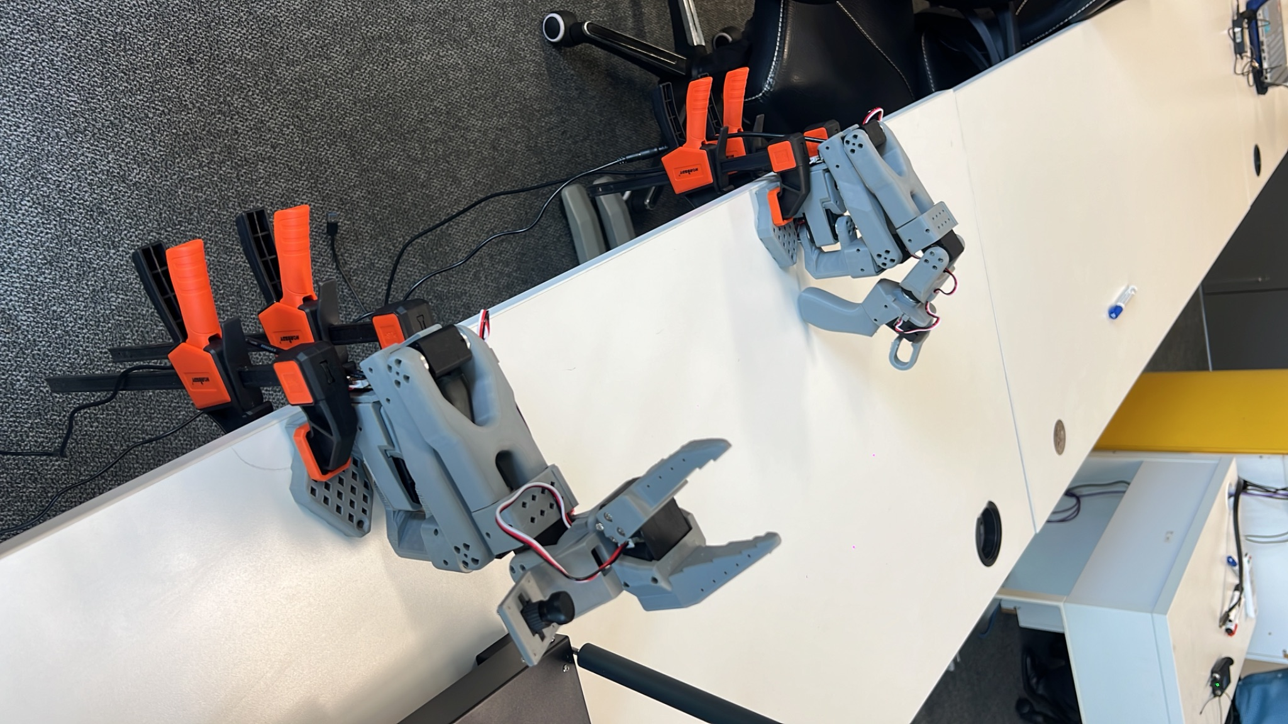
Who Am I & What This Is
I’m Sahil, Master of AI in Business & your TA
My world: AI + Robotics + Embedded Systems
Contact me through whatsapp
This course: learn how data & models can control real hardware
Very hands-on: less talking, more building

Slide 3


What You’ll Be Able To Do
I’ve trained and deployed a AI/ML model on hardware like a microcontroller.
I can use Python to train a robot arm using AI.
By The End of This Course You Can Say…
I know what a microcontroller is and how use it its potential.
I Have collected data with HW.
I can wire and program sensors and motors safely.
I’ve built a group project in embedded AI & robotics.

Slide 4
Assessment Overview
Weekly Tutorials
Midterm Quiz
Final Group Project
Lab tasks + short reflections
Submit via GitHub / email
Group of students
Working embedded AI prototype
Live demo + short report
Basics of microcontrollers, sensors, motors, AI

Slide 5


Is This Course for You?
This course is for you if:
You like learning by building
You’re curious about collecting DATA using hardware + AI
You want projects that stand out on your portfolio/LinkedIn
This course might not be for you if:
You absolutely hate touching hardware or wires
You only want pure theory / coding on a laptop

Slide 6
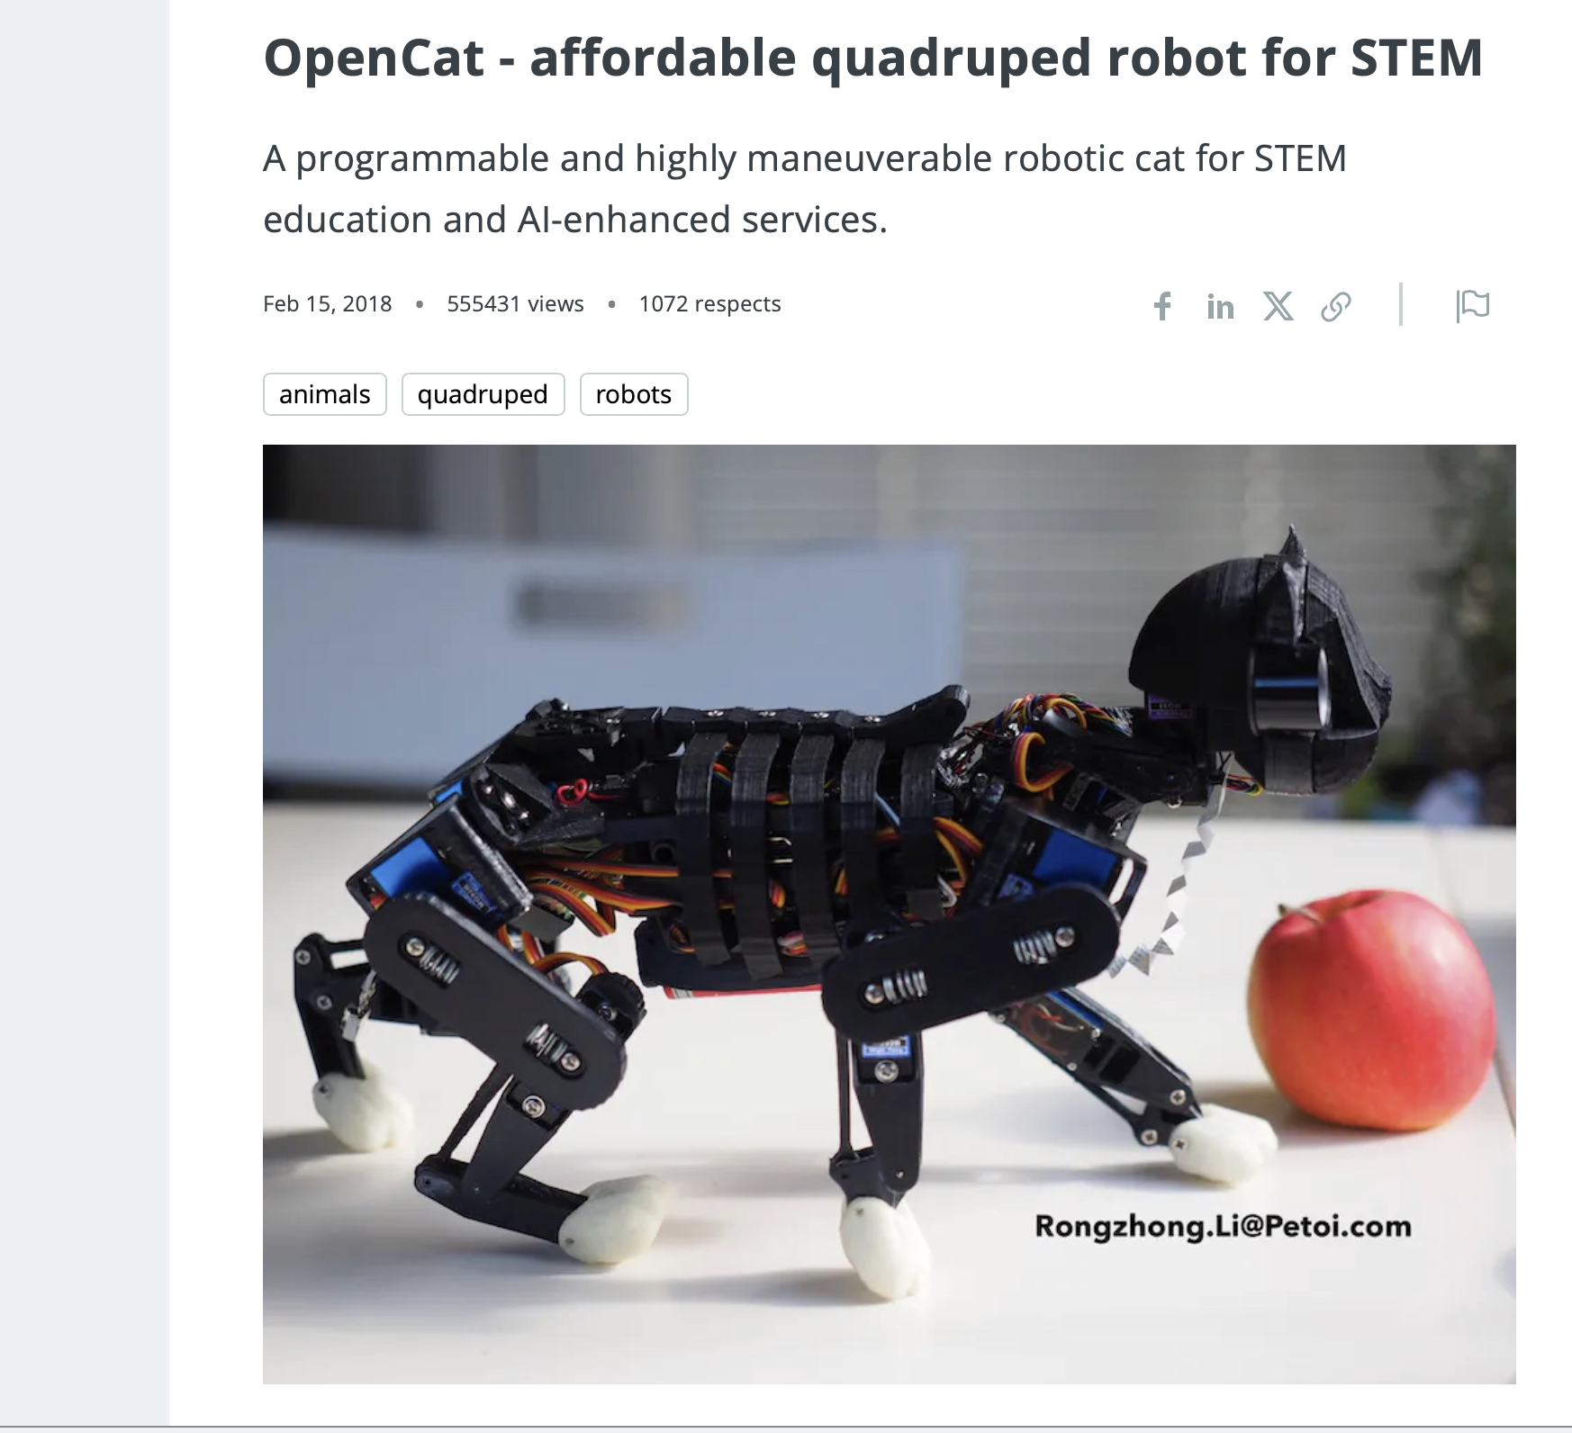
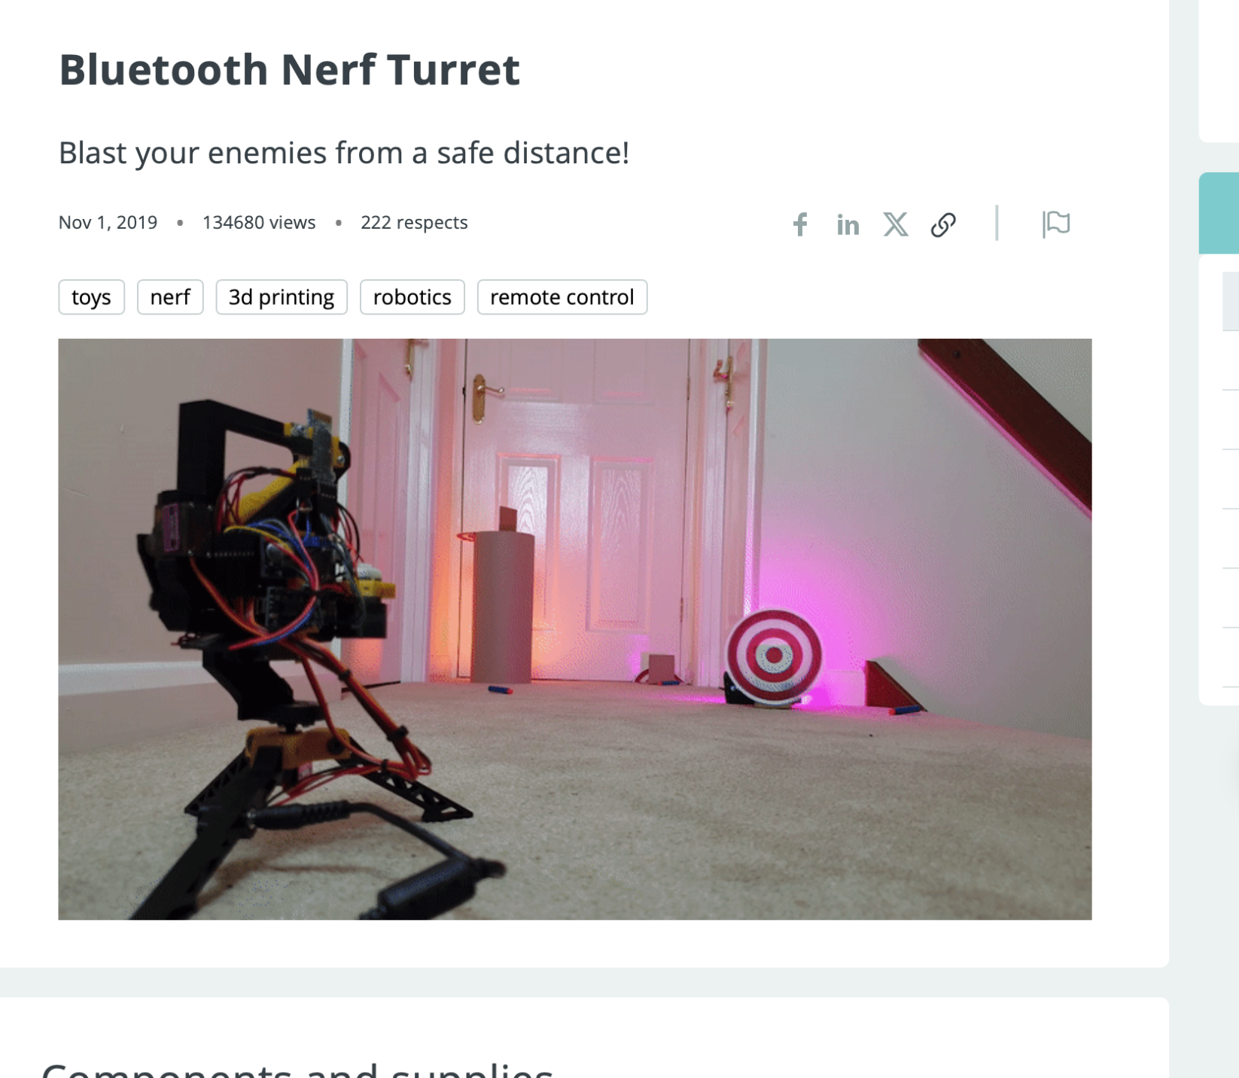
Q&A
?

Slide 7
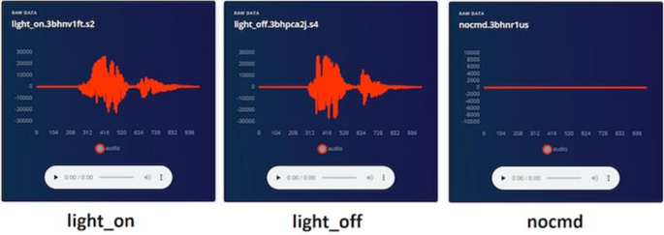
Projects
On-Device Voice Command Classifier for Smart Homes
Gesture-Based Control System with TinyML Classification
Edge Computer Vision Security System with Person Detection
Predictive Maintenance Dashboard Powered by Sensor Time-Series
Emotion-Aware Environment Controller Using Multimodal ML
Hyperlocal Weather Forecasting from Self-Collected Sensor Data
Smart Irrigation & Crop Health Monitor with ML Recommendations
Reinforcement Learning–Driven Autonomous Navigation Robot
Biometric Authentication System with Embedded ML on the Edge

Slide 8
Hardware You’ll Meet
Hardware in This Course
Arduino Uno / Nano
ESP32 / ESP32-CAM
Raspberry Pi 5
SO-101 / SO-100 robot arm
Sensors:
Ultrasonic, LDR, temperature/humidity, accelerometers, etc.
Motors:
DC, servo, stepper

Slide 9
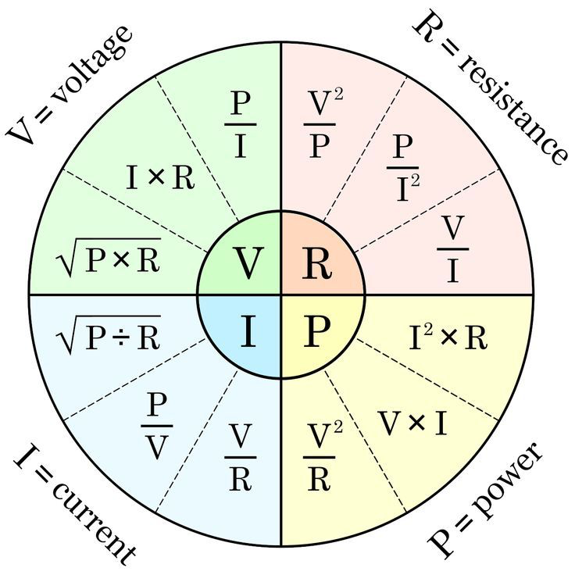
Electricity Basics
Why Ground (GND) Matters**
Ground is the reference point (0V)
All voltages are defined relative to GND
For things to communicate properly:
They must share a common ground
If GND is not connected:
Weird / random behaviour
Sensors and boards don’t agree on “zero”
Voltage (V): how strong the “push” is (like water pressure)
Current (A): how much is flowing (like water flow)
Resistance (Ω): how much it resists flow (like a narrow pipe)
In our labs:
5V – logic and most sensors/LEDs
We do not play with 220V/240V mains

Slide 10
Overview
What Is a Processor?
Inside every computer there is a brain called a processor or CPU
It can:
Read instructions (your code)
Do calculations
Decide what to do next
It works very fast:
Millions or billions of steps per second
On its own, the processor is just a chip – it needs other parts to be useful
Inputs vs Outputs (In Real Life)
Input = things the system can sense:
Buttons, switches
Temperature sensor
Light sensor (LDR)
Microphone, camera, distance sensor
Output = things the system can control:
LEDs, screens
Buzzers, speakers
Motors (wheels, arms, fans)
Relays (turning devices ON/OFF)
What Is a Board?
The processor chip is hard to use alone
So we put it on a board with:
Power connections (5V, 3.3V, GND)
Pins connected to the processor
USB port to talk to a computer
Extra little parts to keep it stable
Examples of boards:
Arduino Uno
ESP32 dev board
Raspberry Pi (more like a mini-computer board)

Slide 11
Overview
The Basic Loop: Sense → Think → Act
Almost all embedded systems follow this loop:
Sense – read inputs
Think – run logic / model
Act – control outputs
Repeat… forever
Example: automatic room light
Sense: light sensor + motion sensor
Think: is it dark? is someone here?
Act: turn light ON or OFF
Why Start with Simple LEDs and Buttons?**
These examples look simple, but they teach:
How to connect things safely
How to read inputs
How to control outputs
How to think in the “Sense → Think → Act” loop
Once you understand this,
Swap button → sensor
Swap LED → motor
Add AI in the “Think” step
Where Does Arduino Fit in the Big Picture?
Arduino board = processor + board + pins
It sits in the middle: Real world → Sensors (input) → Arduino → Outputs (motors, LEDs)
We connect Arduino to:
Our laptop (for programming & debugging)
The physical world (through wires & components)

Slide 12
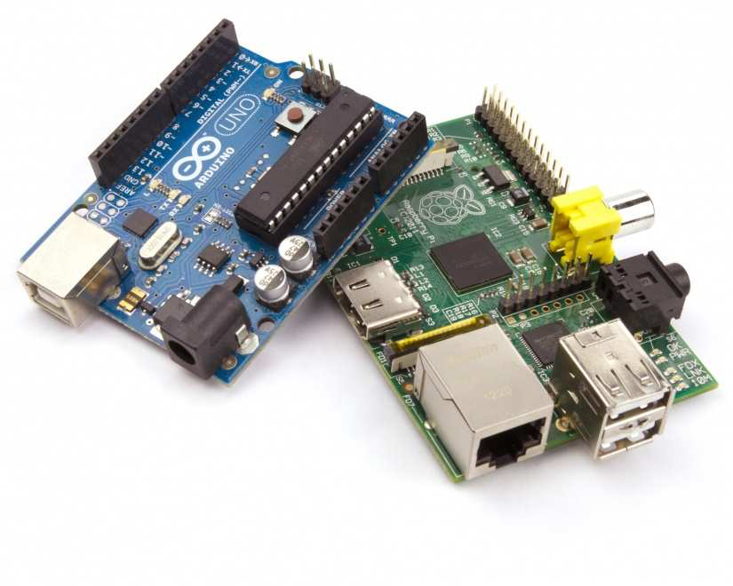
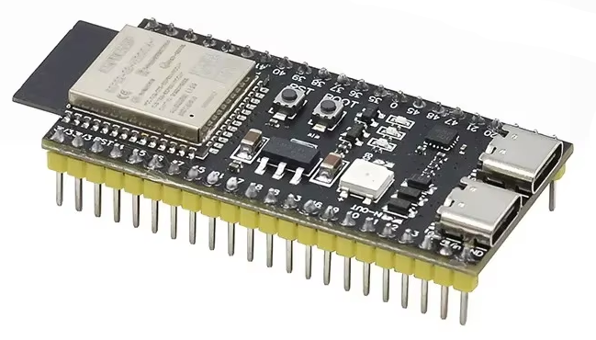
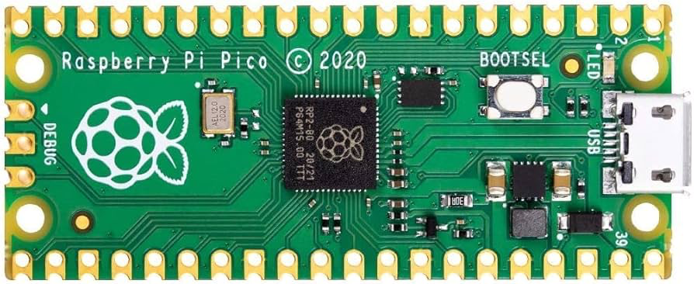
What Is a Microcontroller?
It’s a tiny computer on a small chip
It usually runs one program that repeats again and again
It has pins where you can:
Read things (buttons, sensors) → inputs
Control things (LEDs, motors, buzzers) → outputs
It has no screen, no keyboard, no apps
Very low power:
Can run from a small battery
Used inside everyday devices (toasters, toys, washing machines)

Slide 13
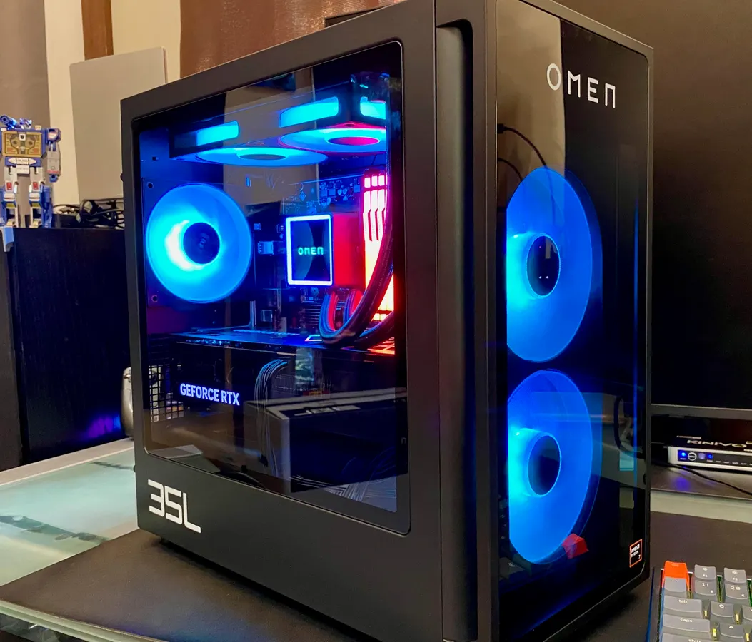
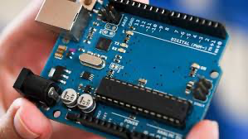

PC vs Cloud vs Microcontroller
Option 1
Option 2
Option 3
Laptop / PC (your Mac or Windows)
Heavy, powerful machine
Runs many apps at once (browser, VS Code, Spotify, etc.)
Great for:
Writing and training ML models
Running big code, Jupyter notebooks
Cloud Server (AWS, Azure, GCP, etc.)
Like a giant remote computer in a data center
Even more powerful: lots of CPUs, GPUs
Great for:
Training large models
Handling millions of users
Needs internet connection to reach it
Microcontroller (Arduino, ESP32)
Very small and cheap
Runs one program again and again
Often has no operating system
Great for:
Talking to sensors
Controlling motors, lights, buzzers
Doing simple AI close to the real world
Can run on a battery and sit in a device for years

Slide 14
Why Are We Using Arduino?
Why Are We Using Arduino?
Arduino is a family of microcontroller boards
Designed to be beginner-friendly
Clear pin labels: 5V, GND, 13, A0 etc.
Lots of example projects online
Big community:
If you get stuck, someone probably had the same problem
Simple to connect:
Plug in USB → select board → upload code
Arduino IDE is made for teaching:
We write small programs called “sketches”
Two functions: setup() and loop()
Buttons: Verify (check code) and Upload (send to board)

Slide 15
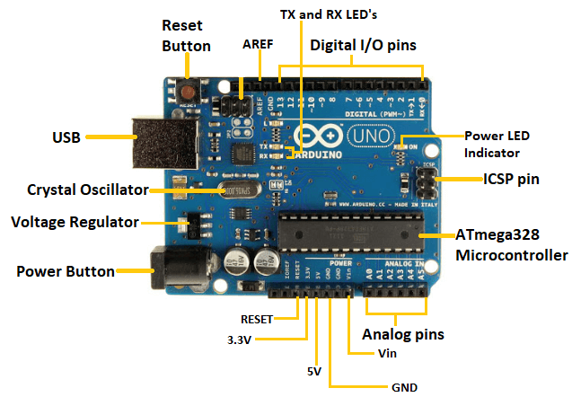
The Arduino Board Tour
USB connector (programming + power)
Power jack (we mainly ignore this in lab)
Digital pins (0–13)
Analog pins (A0–A5)
5V & 3.3V pins
GND pins
Reset button
Power LED & built-in LED (L)

Slide 16
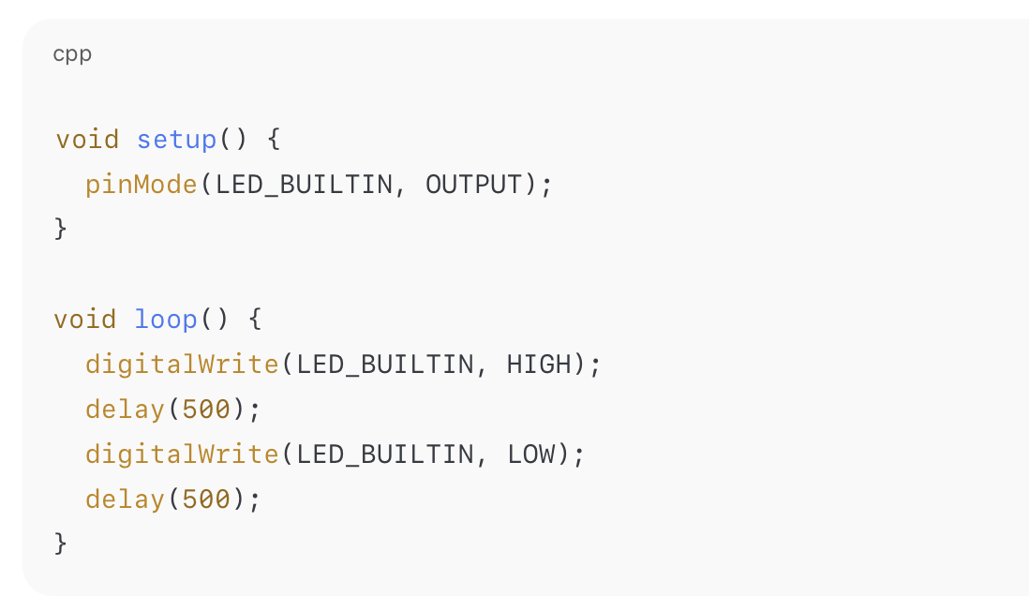

How We Code the Arduino
Language: C/C++ (Arduino style)
Program = “sketch”
Two main functions:
setup() → runs once at the start
loop() → runs forever
Typical pattern:
setup() → configure pins (inputs/outputs)
loop() → read sensors, decide, control outputs

Slide 17



Lab Requirements & Expectations
What You Need for Lab
Bring:
Laptop (with permission to install software)
Arduino kit (board, USB cable, breadboard, basic components)
In lab you will:
Follow GitHub step-by-step guides
Complete 2-3 small tasks per week
Ask lots of questions – confusion is normal
Safety & Lab Rules
Work only with low-voltage circuits in this course
Do not plug random things into mains power
Double-check wiring before powering
If something smells hot, smokes, or is weird:
Disconnect USB / power immediately
Call me or the instructor
Be kind to the hardware – it’s shared

Slide 18
TODAYS TO DO
Install Arduino IDE 2.3.6
Connect Arduino & select Board + Port
Upload the Blink example
Try a custom blink pattern
Build a button + LED circuit
(If time) Try two buttons + two LEDs

Slide 19
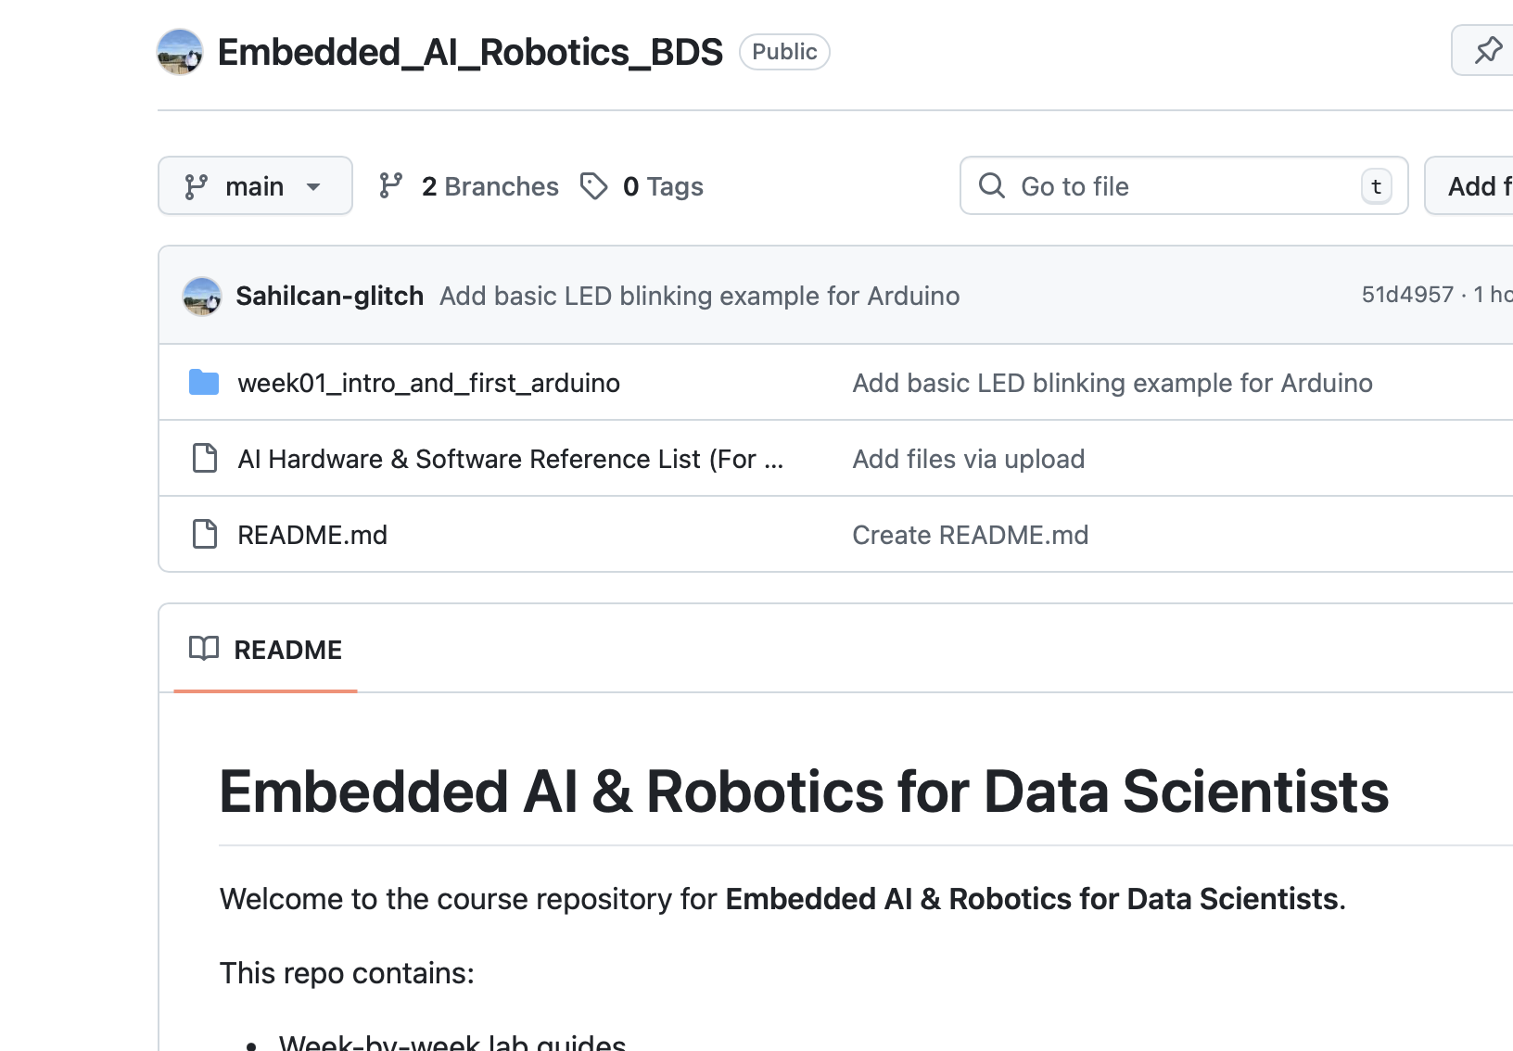
GitHub Repo for This Course
All weekly content is here:
embedded_ai_robotics_bds (https://github.com/Sahilcan-glitch/Embedded_AI_Robotics_BDS)
For Week 1:
week01_intro_and_first_arduino/
README.md = step-by-step lab guide
INSTALL_AND_SETUP.md = install instructions with screenshots
code_examples/ = example .ino files

Slide 20
Q&A
?

